Slide 1
Twin and Adoption Studies

Slide 2
Content
Nature/nurture debate
twin studies
adoption studies
intelligences as measured by intelligence quotient (IQ)

Slide 3
Nature vs. Nurture
The fundamental question!
To what extent is intelligence?
Purely a ‘nature’ trait – genes
Purely a ‘nurture’ trait – environment
A combination of both
Can use twin or adoption studies to test this

Slide 4

Twin Studies

Slide 5
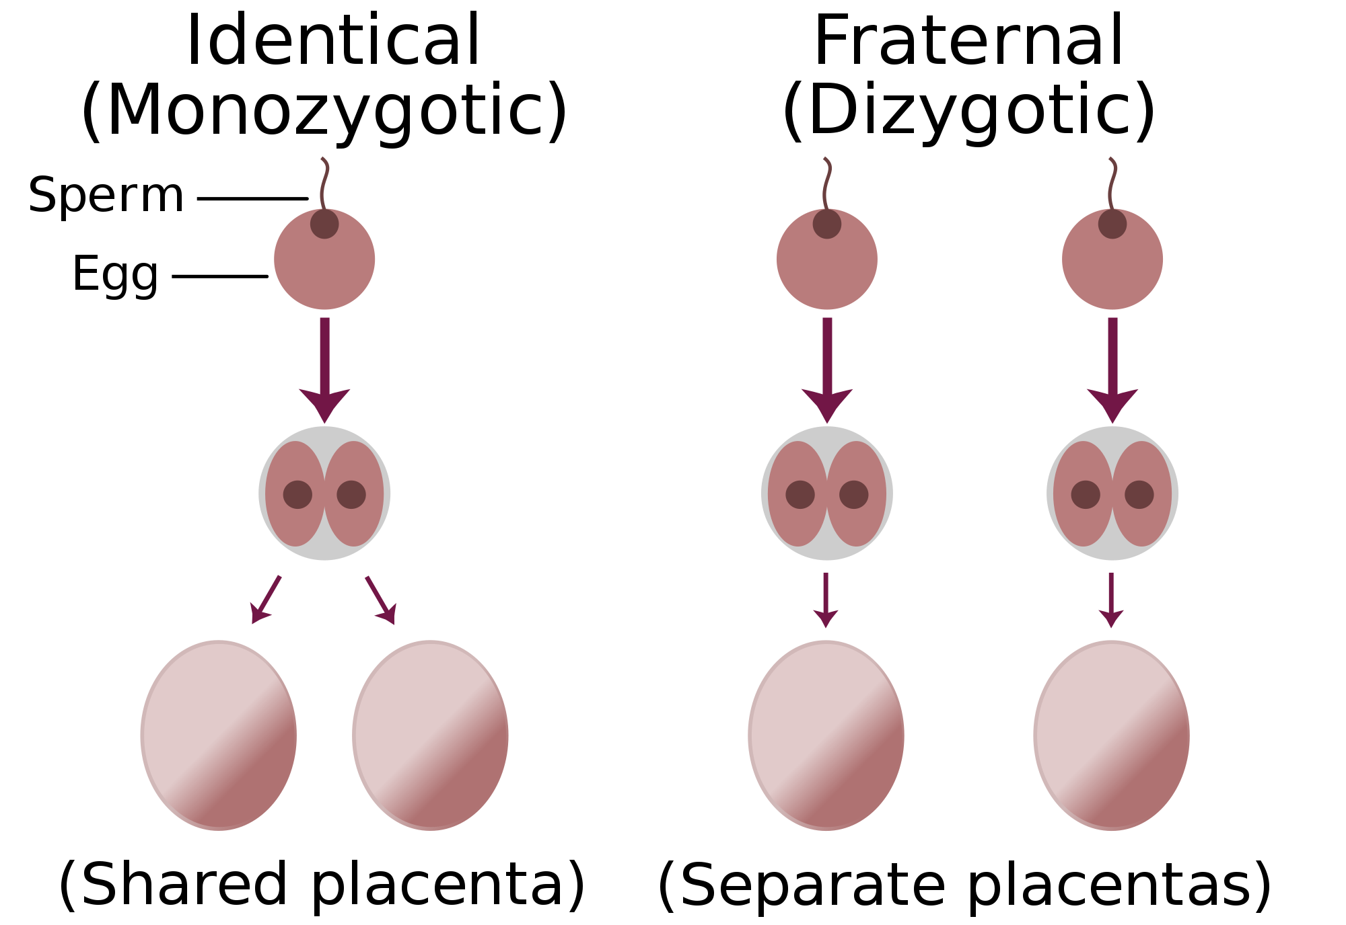
Twins

Slide 6
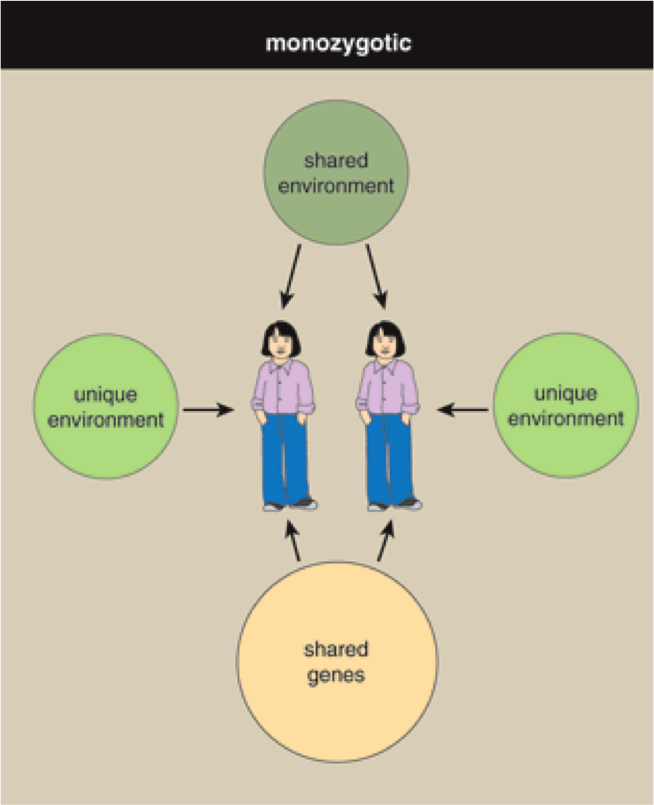
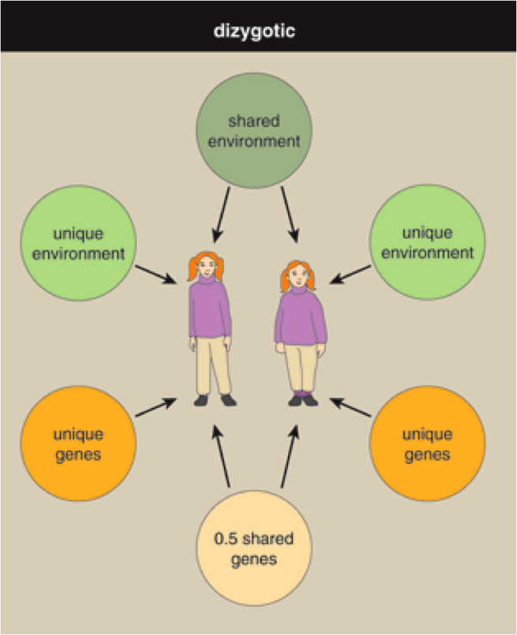

Slide 7
Degree of Relationship | Degree of Gene Similarity
MZ | 100%
DZ | 50% (approximately)
Siblings | 50% (approximately)
Adopted Children | None

Slide 8
Comparing Monozygotic twins (MZ) with Dizygotic twins (DZ). Since MZ twins have identical DNA, there should be a higher concordance rate
The probability that a pair of individuals will both have a certain characteristic, given that one of the pair has the characteristic
If intelligence is purely nature then MZ should be identical and DZ should be different

Slide 9
Feature | Interpretation
MZ concordance is significantly higher than DZ concordance | The disorder has a genetic component.
MZ concordance is same or similar to DZ concordance | The disorder is environmentally caused.
MZ concordance is 100% | The disorder is genetically caused.
MZ concordance is significantly less than 100% | The disorder has an environmental component.

Slide 10
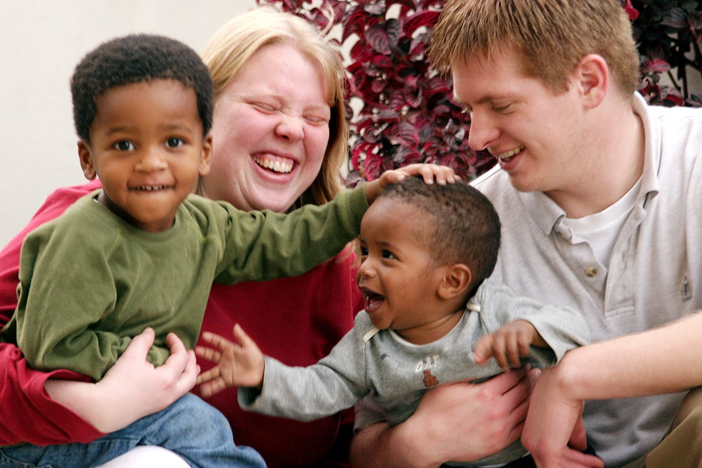
Adoption Studies

Slide 11
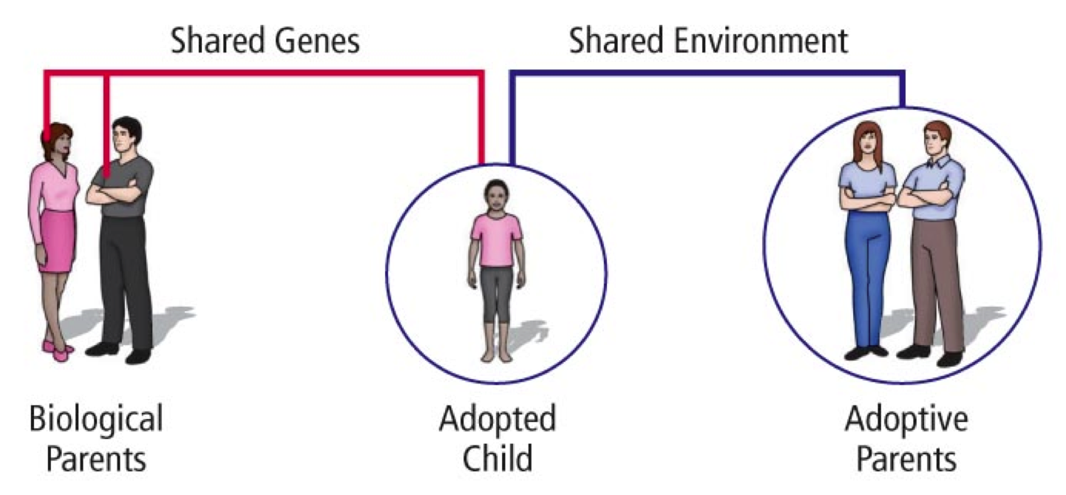

Slide 12
Adoption studies tend to compare the adopted child with the biological mother and the adoptive mother to determine which has the higher concordance rate for a given behaviour
If an adopted child has a higher concordance rate for intelligence to their adopted parent compared to their biological parent, is it more nature or nurture?
Why might adoption studies at times be preferable to twin studies?

Slide 13
Twins Reared Apart
Studies can also investigate MZ and DZ twins that were reared apart
Less common form of study

Slide 14
Advantages and Disadvantages of Twin Studies
Strengths:
Twin studies have produced a great deal of data in support of biological roots of disorders; this has helped psychologists to stress prevention for those who are vulnerable to such disorders
There is a high cross-cultural reliability of concordance levels

Slide 15
Advantages and Disadvantages of Twin Studies
Limitations:
MZ twins are rarely separated at birth and raised
in a totally different environment, yet this is really necessary to
substantiate claims.
MZ twins reared together share many of the same experiences.
DZ twins reared together may not share the same experiences
due to levels of attractiveness or temperament

Slide 16
Advantages and Disadvantages of Adoption Studies
Strengths:
Adoption studies allow researchers to isolate variables
If a biological mother has no contact since birth and still matches for a specific trait - for example, the adopted child’s IQ is better than the adoptive mother and in concordance with the birth mother - this is strong evidence that genes play a significant role in the development of this trait

Slide 17
Advantages and Disadvantages of Adoption Studies
Limitations:
Selective placement is a problem. Babies tend to placed with families similar in background to the natural parents
Adopted children – as well as twins - are not representative of all children
The act of being given up for adoption may affect the child’s behaviour

Slide 18
Empirical Studies
To what extent is intelligence (as measured by IQ) a result of nature or nurture?

Slide 19
Bouchard & McGue (1981) Meta-analysis of Siblings
Conducted a meta-analysis of 111 studies of siblings
Investigated IQ correlations between siblings
Found that there was a positive correlation between kinship and IQ correlation - the closer the siblings were, the more similar their IQ

Slide 20
Evaluation of study:
Large study, so generalisable
However, siblings are raised in the same environment, so influence may not be purely genetic, and it is difficult to differentiate between influence of genetics and environment
Also, age - the further apart the siblings in age, the less correlated their IQs are expected to be

Slide 21
In order to investigate the role of genetics by itself, identical twins that are raised separately from birth must be studied. Identical twins have a 100% genetic relationship, but if raised in separate environments, any similarity (beyond that expected by chance) in IQ must be due to similarity in genetics

Slide 22
Horn et al. (1979) The Texas Adoption Study
Conducted a study on parents who raised BOTH adopted and natural children
All children have the same upbringing, therefore same environment, but some were similar in genetics and some were not
Found no significant differences in correlation of parent-child IQs between natural and adopted children
Adoptive parents were wealthy, white, middle class and children were poor, lower class backgrounds, with lower IQ parents
Conclusion that genetics has little impact - mostly environment

Slide 23
Wahlsten (1987) French Adoption Study
Well controlled adoption studies in France
Transferred infant from family with low socio-economic status to with high economic status parents
Increased IQ of children by 12-16 points
Suggests that environment has a lot to do with intelligence, as well genetics - enriched environment = good

Slide 24
Daniels & Plomin (1985)
Longitudinal study- tested sociability vs shyness of children adopted at 12 and 24 months
Found heredity played a role in shyness- extreme shyness in biological mum → shy child at 2 years
Also found that family environment was also important in the development of shyness – shyness in adoptive mum → shy child at 2 years

Slide 25
Followed children of two groups of mothers- low and high intelligence
Adopted at birth by parents of above income and education
Children from low IQ mothers scored above average in IQ
Children from high IQ mothers scored even higher though
Shows that both heredity and environment play a part in IQ development

